Slide 1
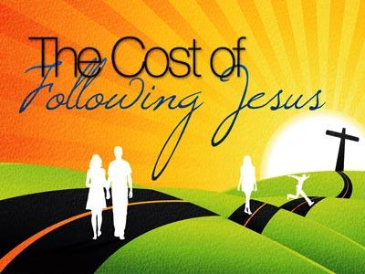
Luke 9:23, 14:26-27
Pastor Rod M. Lago

Slide 2

I.
C - OMMITMENT

Slide 3
Commitment to God’s Word – Jos. 1:8, Matt. 4:4, 1 Tim. 3:14-17
Commitment to God’s Will – 1 Tim. 1:1
Commitment to Making Disciples – Matt. 28:19-20, 2 Tim. 2:2

Slide 4

II.
O - BEDIENCE

Slide 5
Obedience to Hate our Families and Ourselves. – Luke 14:26
Obedience to carry our own Cross. – Luke 14:27

Slide 6
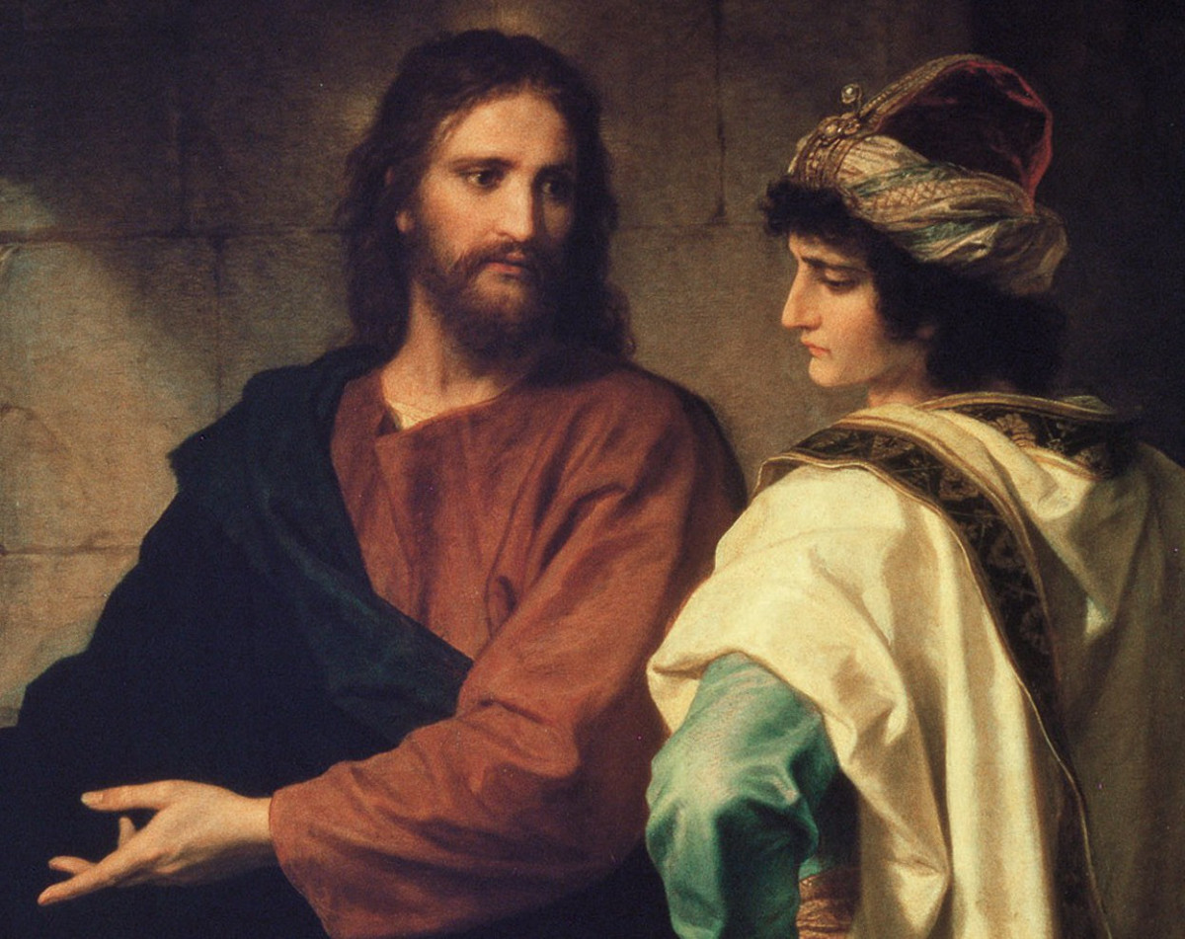
III.
S - ACRIFICE

Slide 7
Sacrifice our Treasures.
Sacrifice our Time.
Sacrifice our Talents.
Sacrifice our True Life.

Slide 8
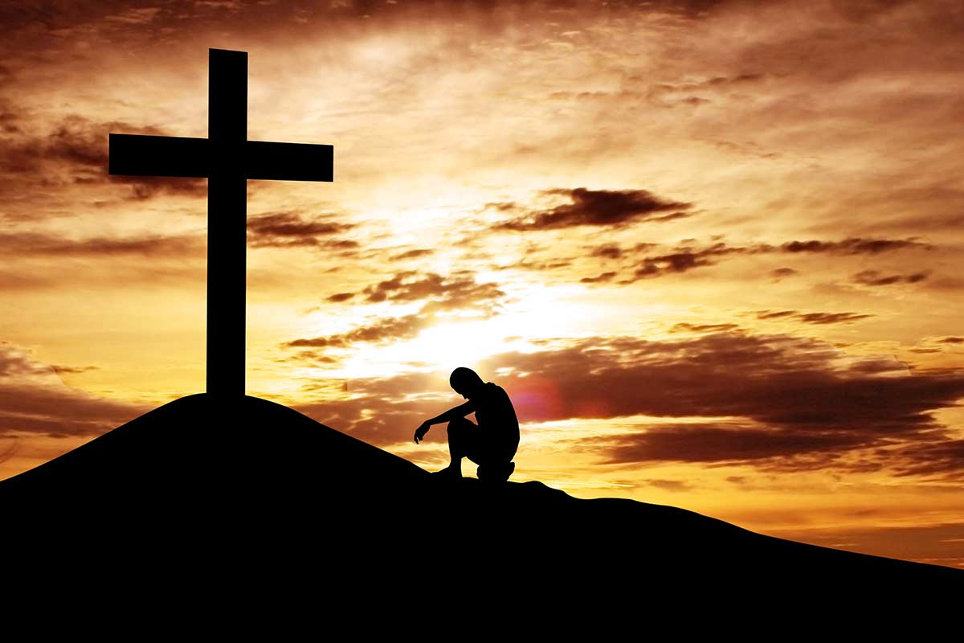
IV.
T – ENACITY.

Slide 9
Tenacity means: having a “NEVER GIVE UP ATTITUDE.”

